Slide 1

Advanced Software Testing

Slide 2
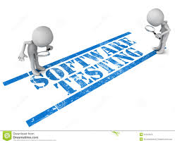

Slide 3
Testing
“Testing is the process of executing a program with the intention of finding errors.” – Myers
“Testing can show the presence of bugs but never their absence.” – Dijkstra
Testing is the process of exercising a program with the specific intent of finding errors prior to delivery to the end user.

Slide 4
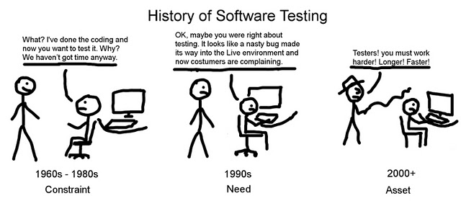

Slide 5
Who Tests the Software?
developer
independent tester
Understands the system
Must learn about the system,
but, will test "gently"
but, will attempt to break it
and, is driven by "delivery"
and, is driven by quality

Slide 6


Slide 7


Slide 8
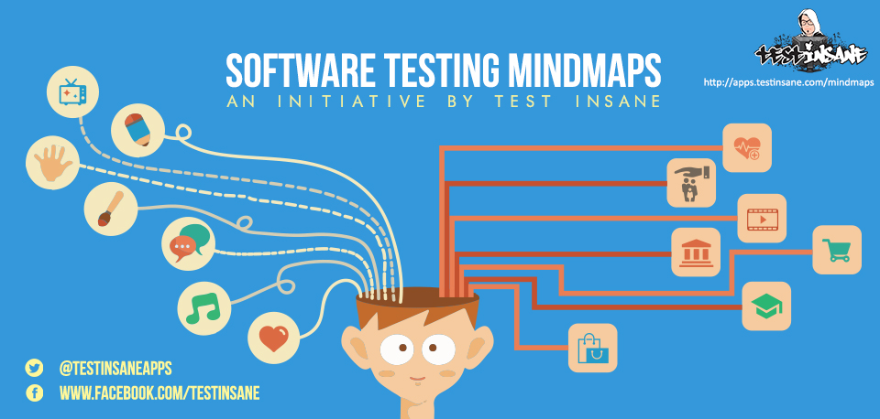

Slide 9
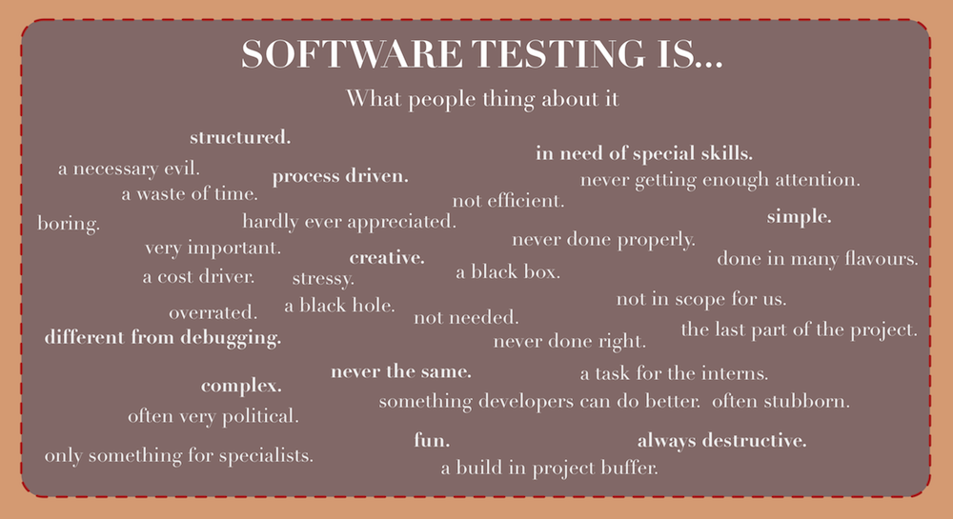

Slide 10
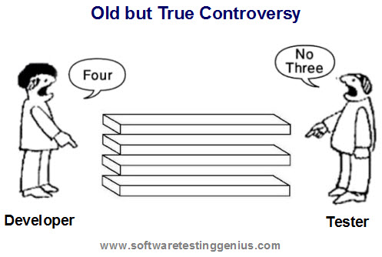

Slide 11
Characteristics of Testable Software
Operable
The better it works (i.e., better quality), the easier it is to test
Observable
Incorrect output is easily identified; internal errors are automatically detected
Controllable
The states and variables of the software can be controlled directly by the tester
Decomposable
The software is built from independent modules that can be tested independently
Simple
The program should exhibit functional, structural, and code simplicity
Stable
Changes to the software during testing are infrequent and do not invalidate existing tests
Understandable
The architectural design is well understood; documentation is available and organized

Slide 12
Test Characteristics
A good test has a high probability of finding an error
The tester must understand the software and how it might fail
A good test is not redundant
Testing time is limited; one test should not serve the same purpose as another test
A good test should be “best of breed”
Tests that have the highest likelihood of uncovering a whole class of errors should be used
A good test should be neither too simple nor too complex
Each test should be executed separately; combining a series of tests could cause side effects and mask certain errors

Slide 13
General Characteristics of Strategic Testing
To perform effective testing, a software team should conduct effective formal technical reviews
Testing begins at the component level and work outward toward the integration of the entire computer-based system
Different testing techniques are appropriate at different points in time
Testing is conducted by the developer of the software and (for large projects) by an independent test group
Testing and debugging are different activities, but debugging must be accommodated in any testing strategy

Slide 14
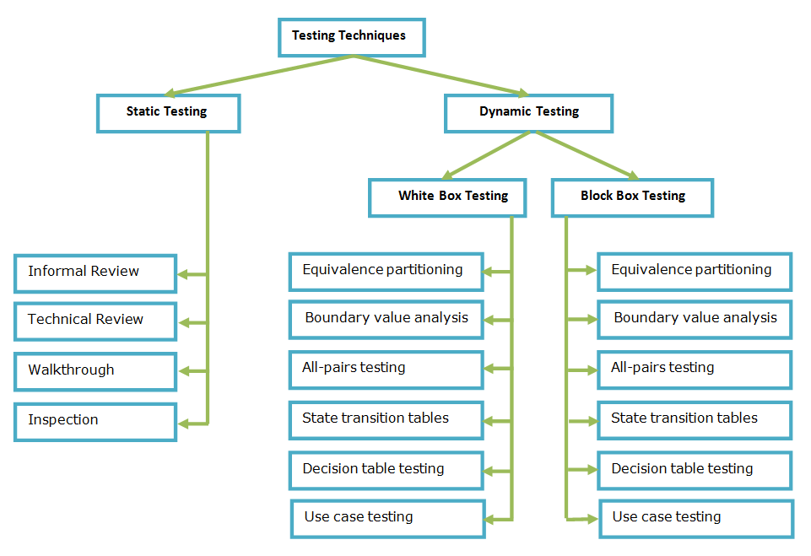

Slide 15
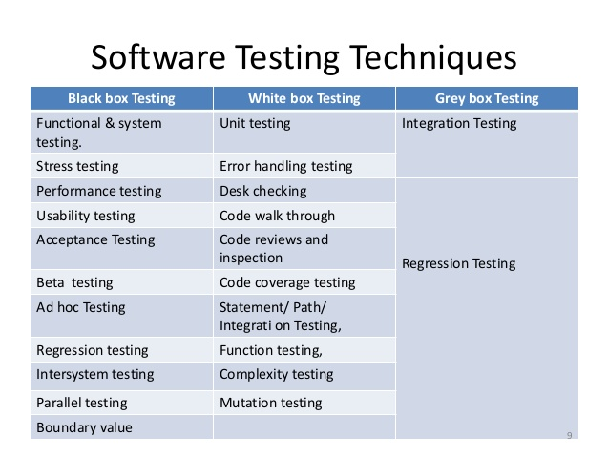

Slide 16
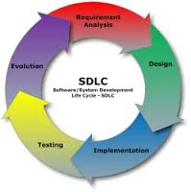

Slide 17
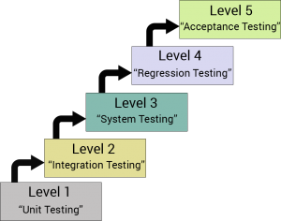
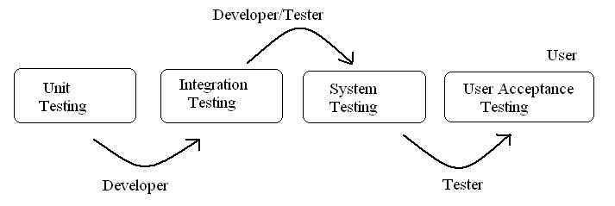
Levels of Testing

Slide 18
Thank You

